Slide 1



MOVIE SUCCESS
Presented By Yesmelin Perdomo, Alyssa Jones, Amanda Lor, Marisol Trejo

Slide 2




MOVIE
Can we predict if a movie will be successful before it’s even released?

Slide 3



Factors
No. 1
No. 2
No. 3
Genre
Comedy, Action, Horror
Actors
Jim Carrey, Jackie Chan, Patrick Wilson
Ratings
IMDB movie ratings
Rotten Tomatoes
Finance
Budget
Revenue
Notes:
We selected csv files that contained these factors

Slide 4



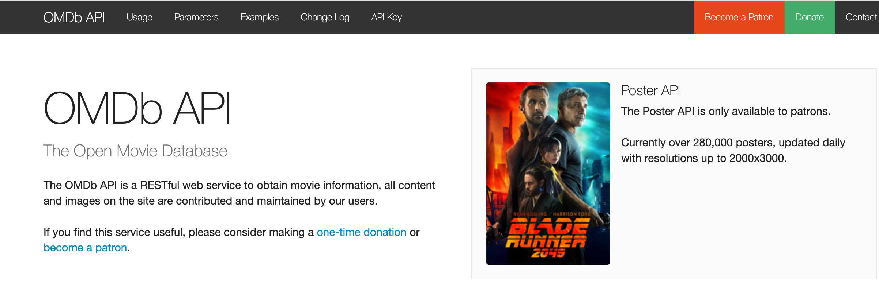
DATA CHOICE

Slide 5
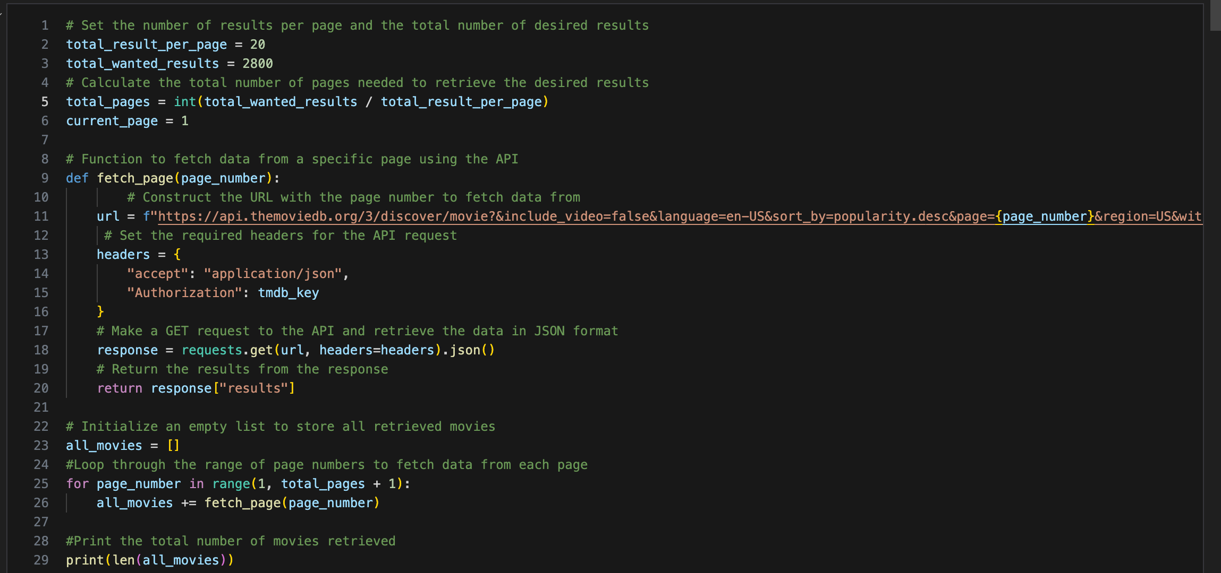
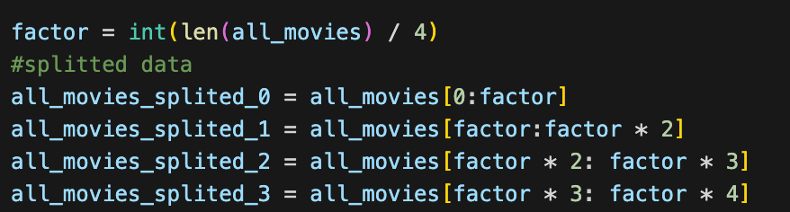
CLEANING DATA

Slide 6
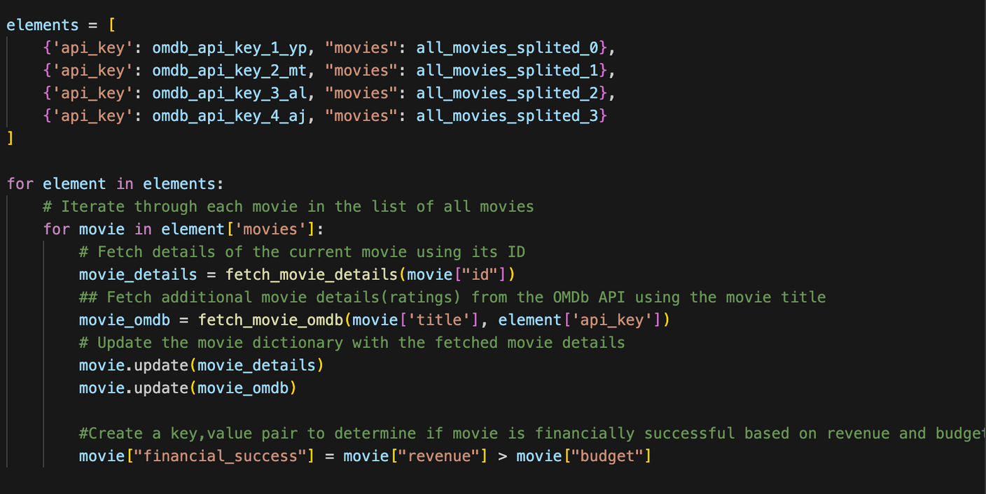
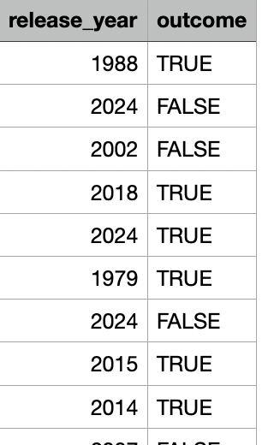
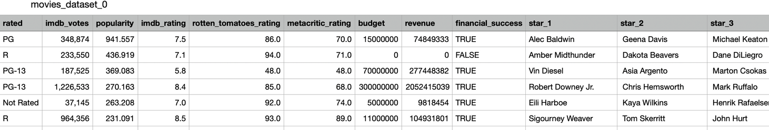
CLEANING DATA

Slide 7
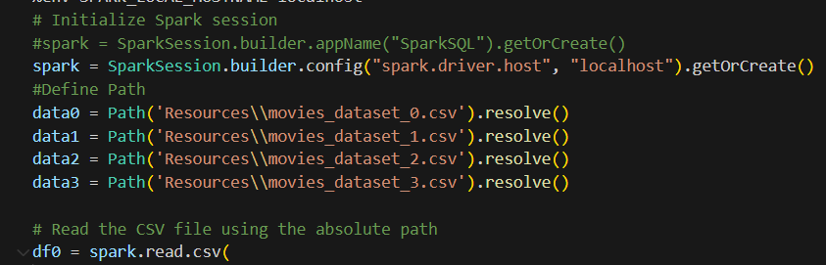

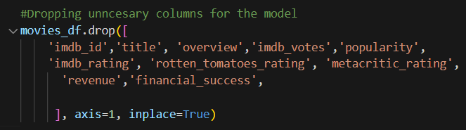
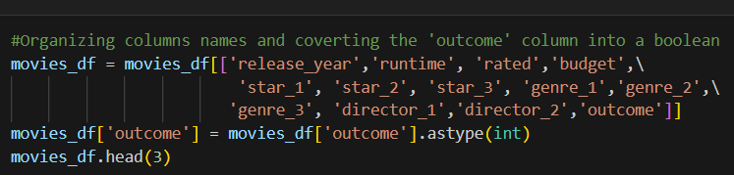
Processing Of Data
Notes:
CSV Read them , and union them Converted to Pandas
Used sparks

Slide 8
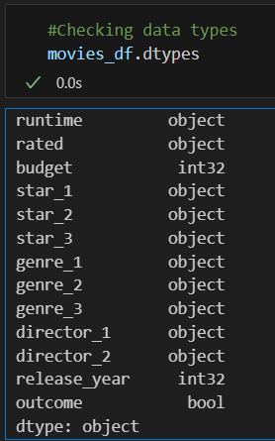

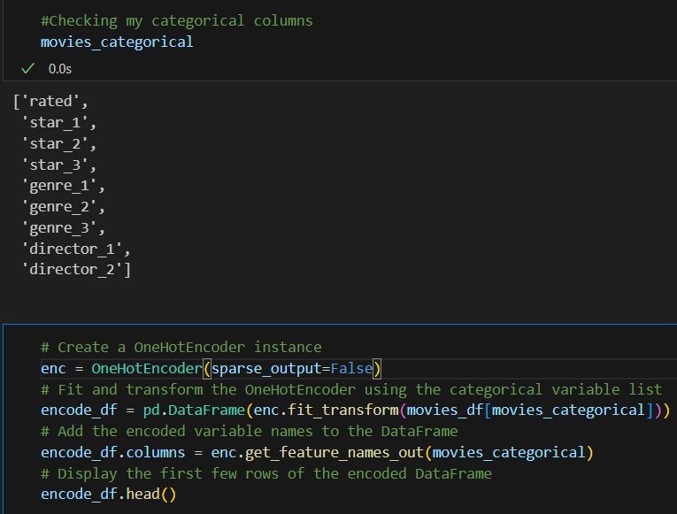
Processing Data

Slide 9
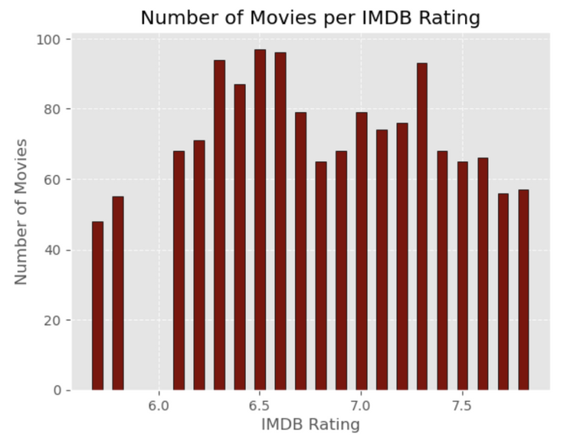
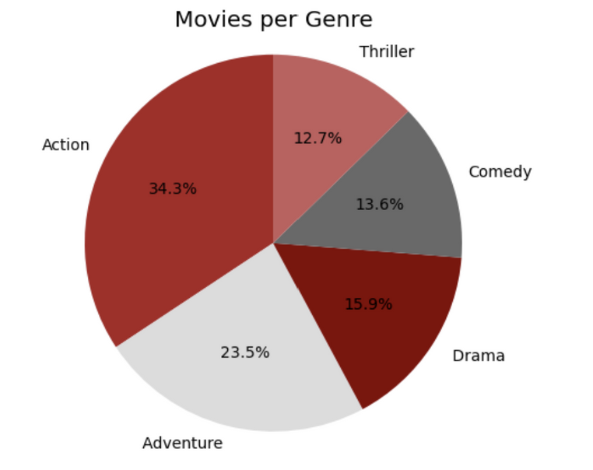
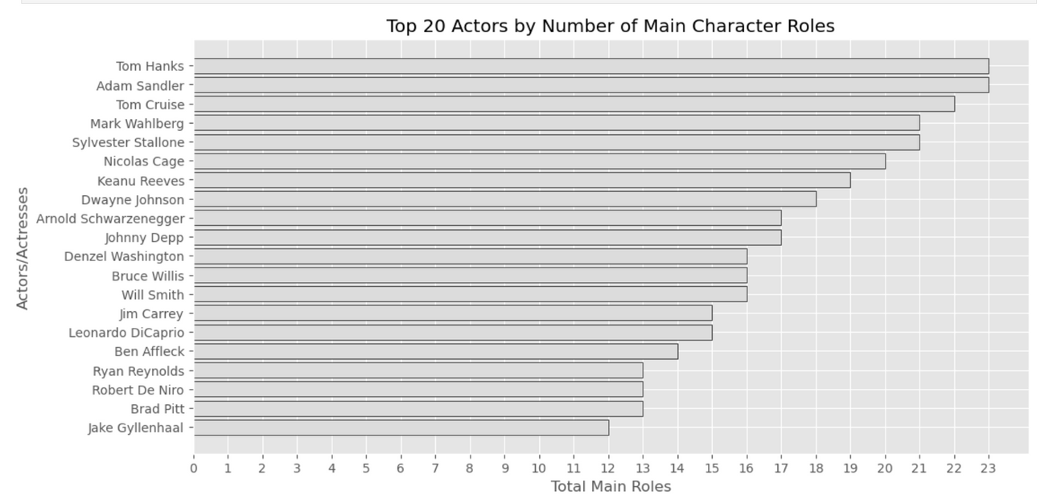
Visualizations
Notes:
Machine Learning Models

Slide 10
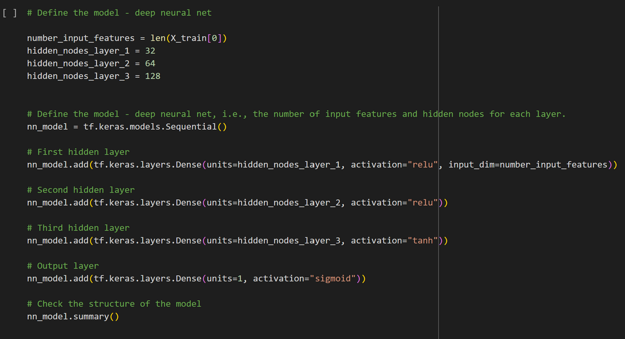
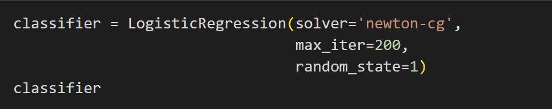
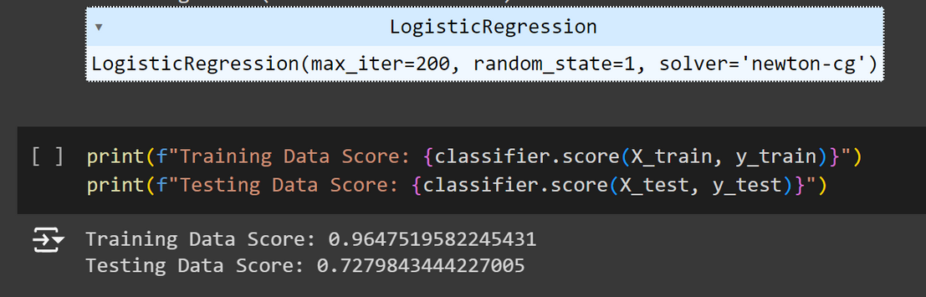
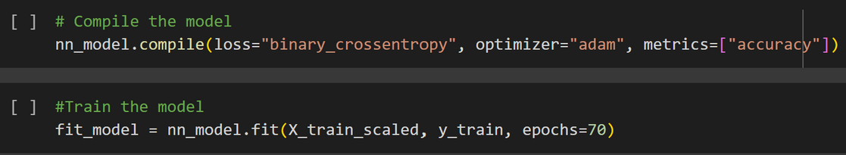
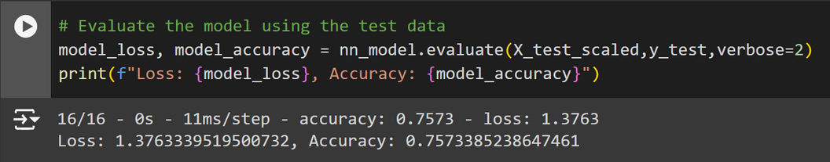
DEEP NEURAL NET
TENSOR FLOW
LOGISTIC REGRESSION
Notes:
Machine Learning Tensor Flow

Slide 11
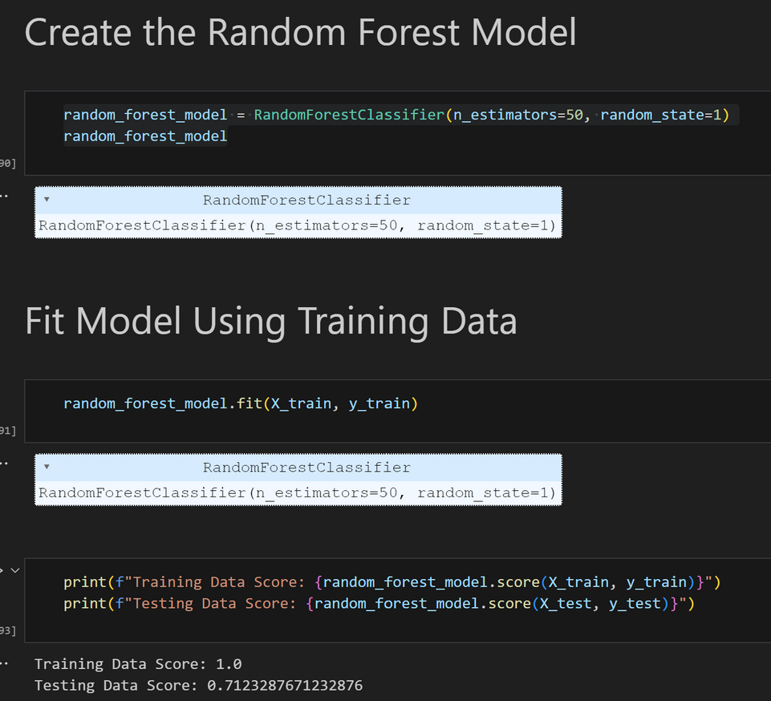
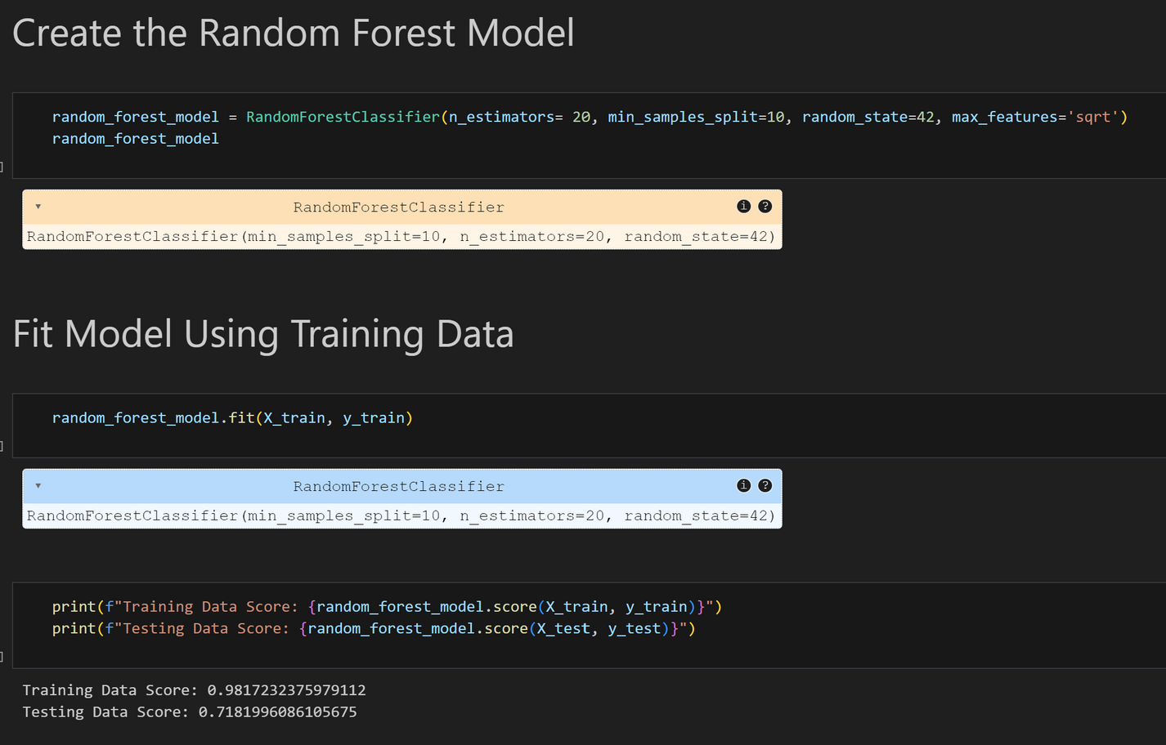
Random Forest Model: Test 1-2

Slide 12
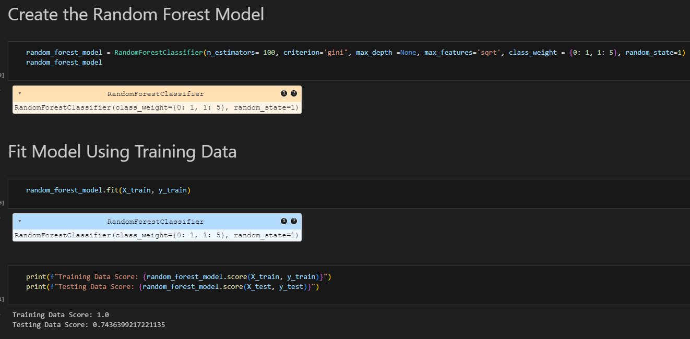
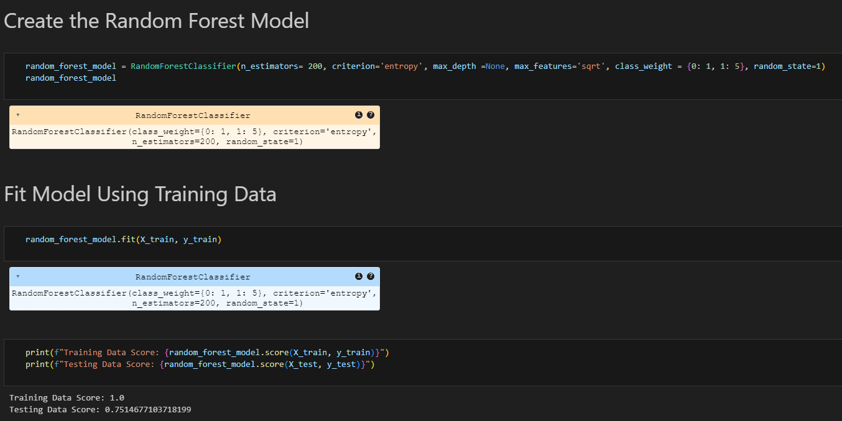
Random Forest Model: Test 3-4
Final Accuracy of 75.1%

Slide 13

Limitations of Data
Only 1000 calls on the API per day
For-loops being created to ensure no overlap, leading to multiple csv files, with limited data
Future Approaches
More fine-tuning of the model to improve accuracy
Simplified data in a single file, to ensure formality
Notes:
Limitations of your data/model
Learnings/Challenges

Slide 14

Conclusion
The random forest model was the best method to achieve high accuracy
In the future, a more simplized data set, with more data could be used
This model provides a high level of accuracy to answer the success of a future movie

Slide 15

Questions
Notes:
Future Approaches

Slide 16
thanks for
LISTENING
End

